Slide 1
Logging in Python
Why? When? And How?
PyCon PL 2023, Vagiz Duseev

Slide 2
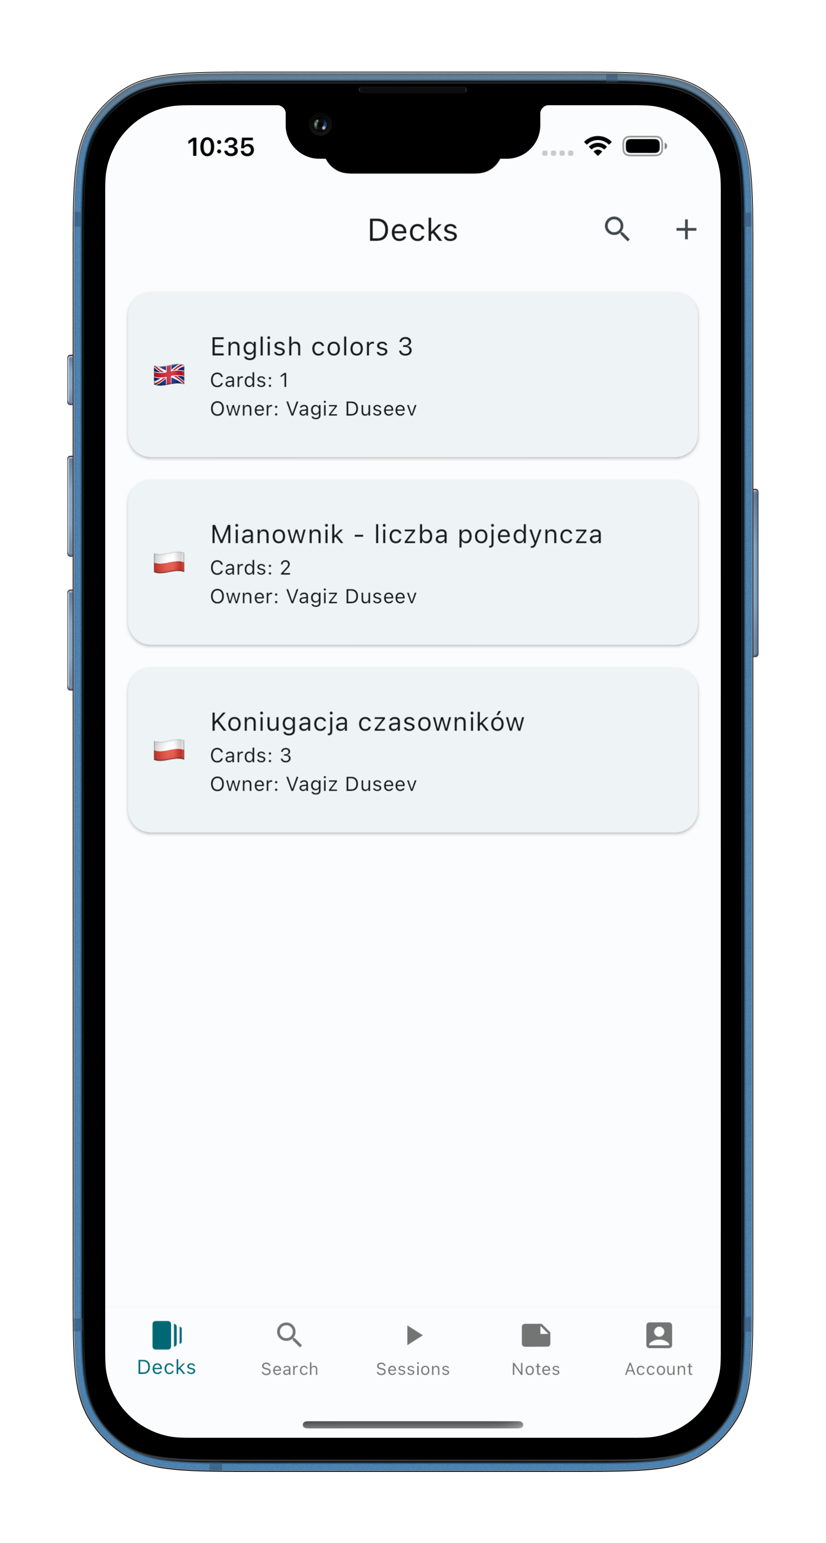
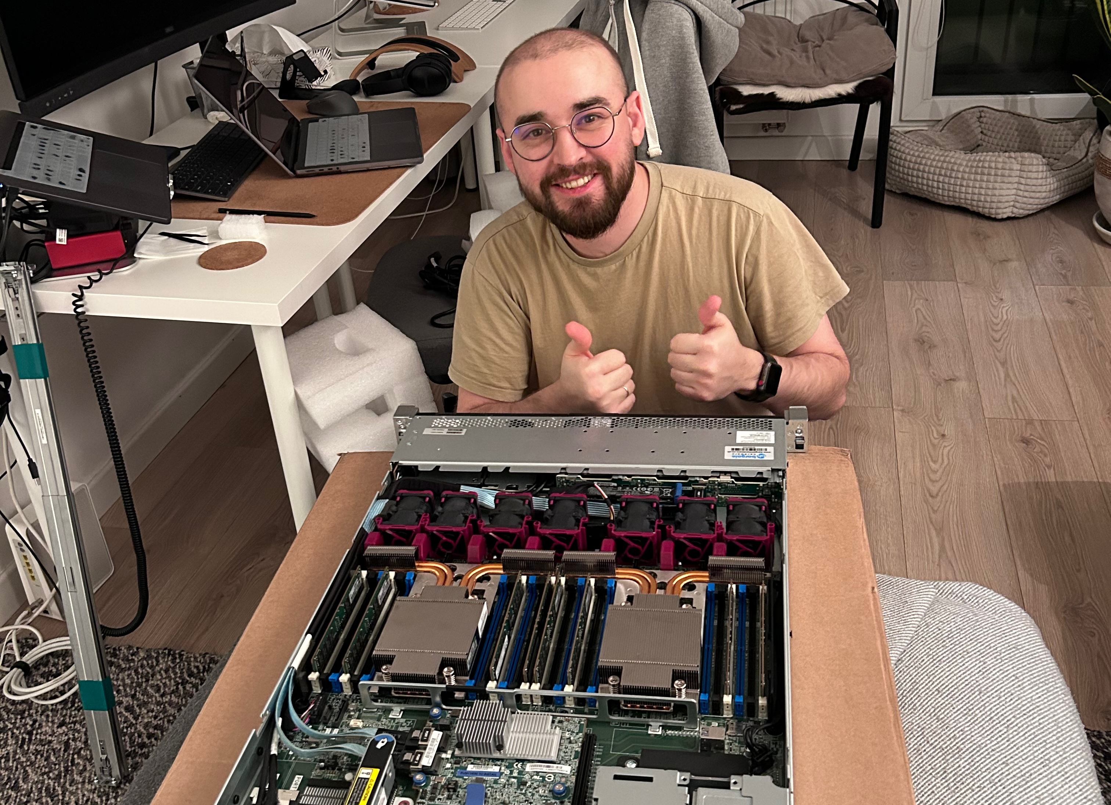
Vagiz Duseev
@vduseev
vagiz@duseev.com

Slide 3
Why logging is a problem?
First, it starts very simple
Gets more complicated over time
Adds more overhead in production
Becomes crucial during incidents
Turns into a headache at large scale and distribution

Slide 4
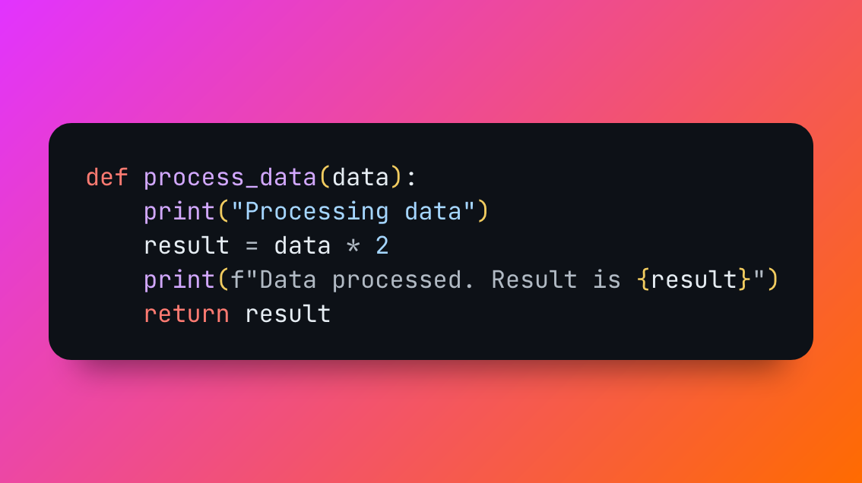
It starts simple
Let’s take a look
Example 1

Slide 5
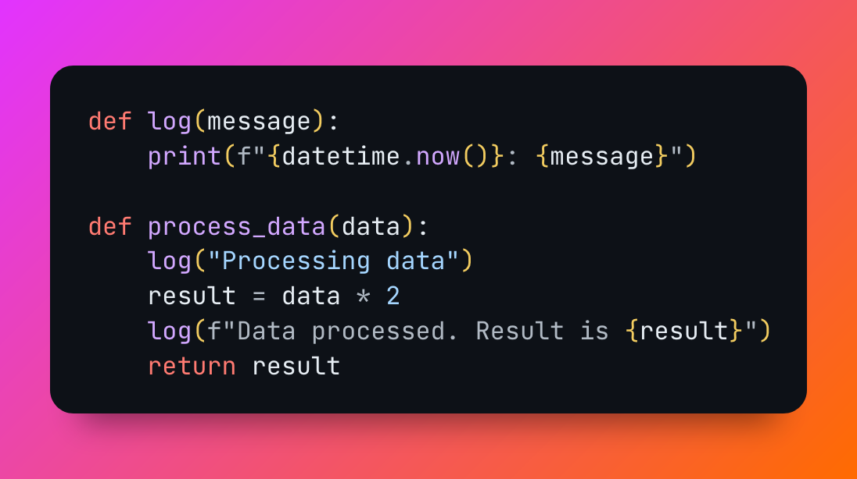
How about a timestamp?
Let’s take a look
Example 2

Slide 6


Slide 7
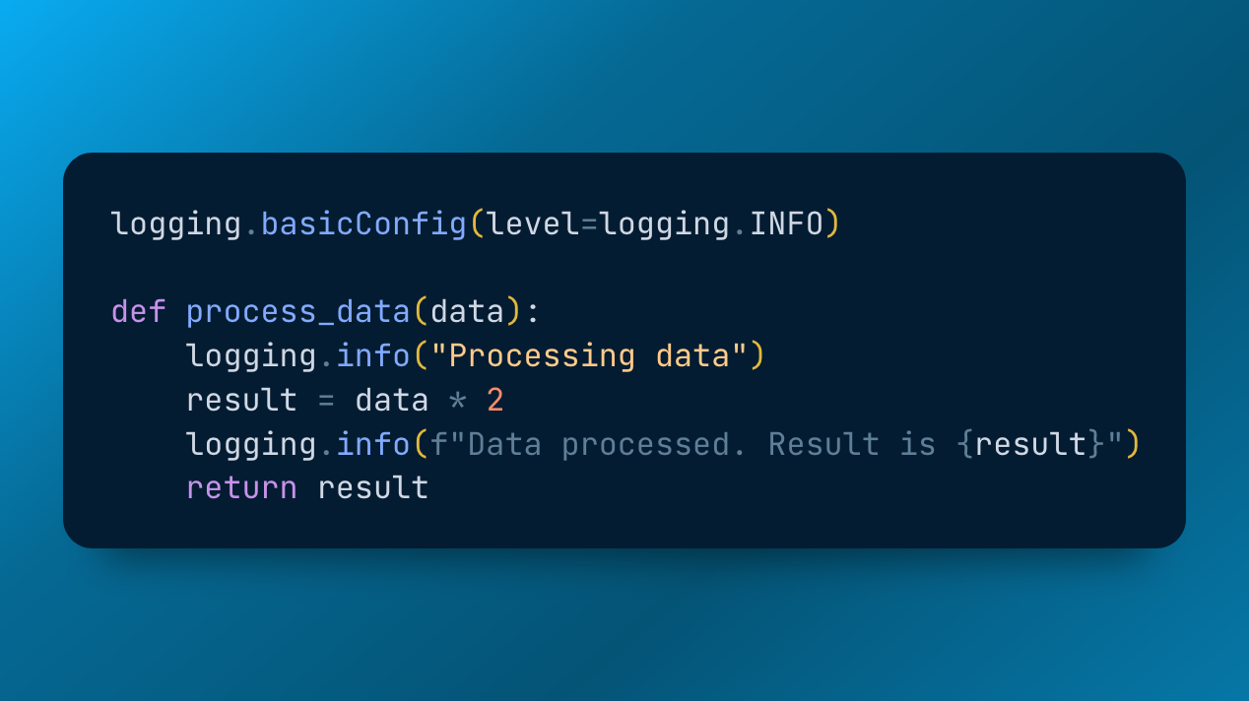
Let’s get logging
Let’s take a look
Example 3

Slide 8
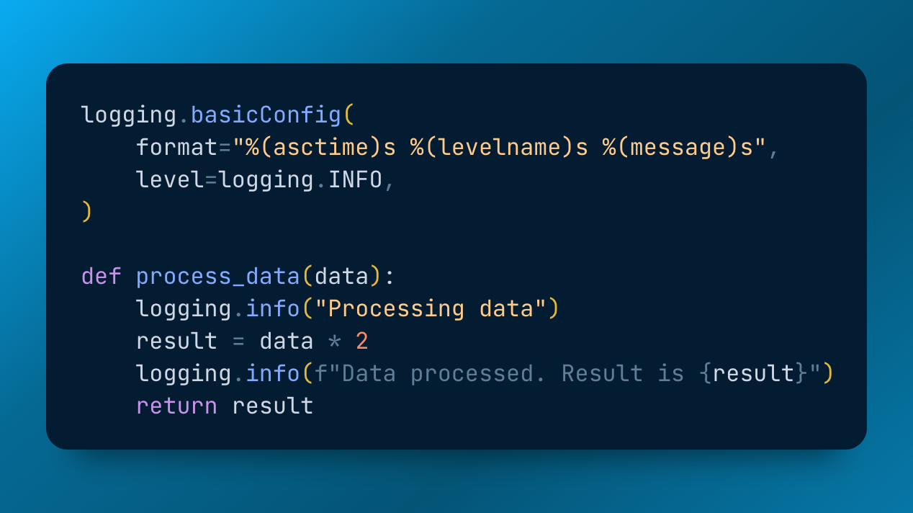
Give me my timestamp back
Let’s take a look
Example 4

Slide 9
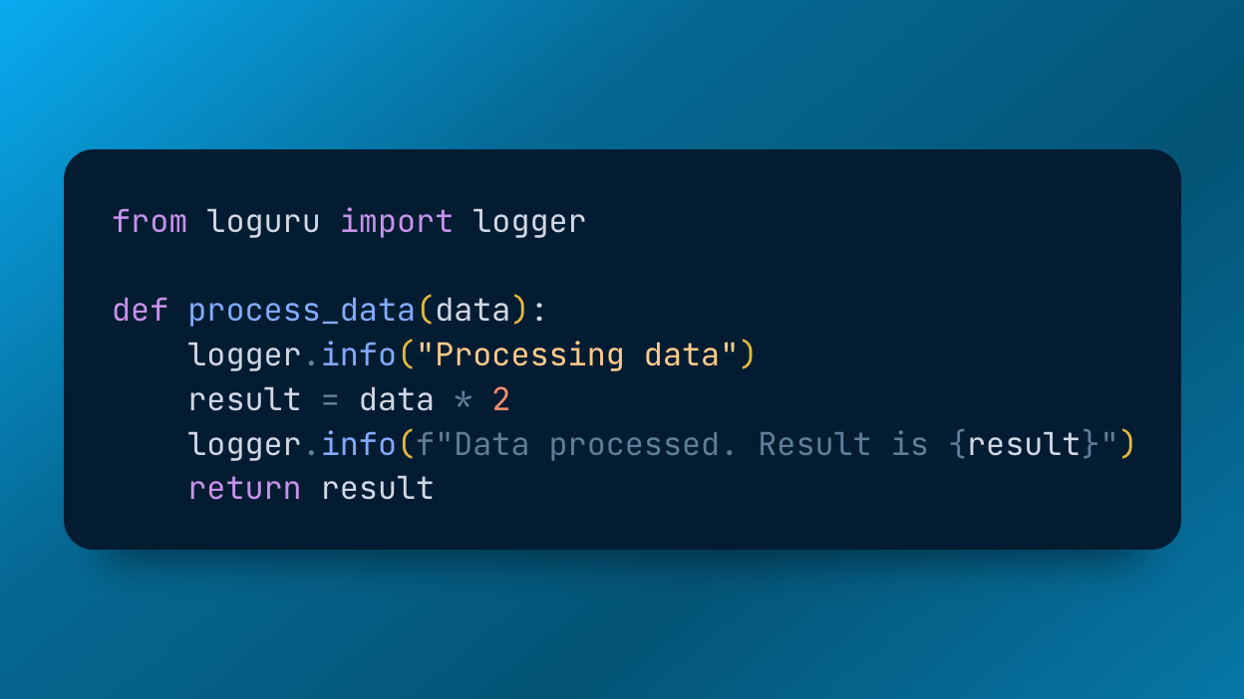
Let’s try something else
Let’s take a look
Example 5

Slide 10
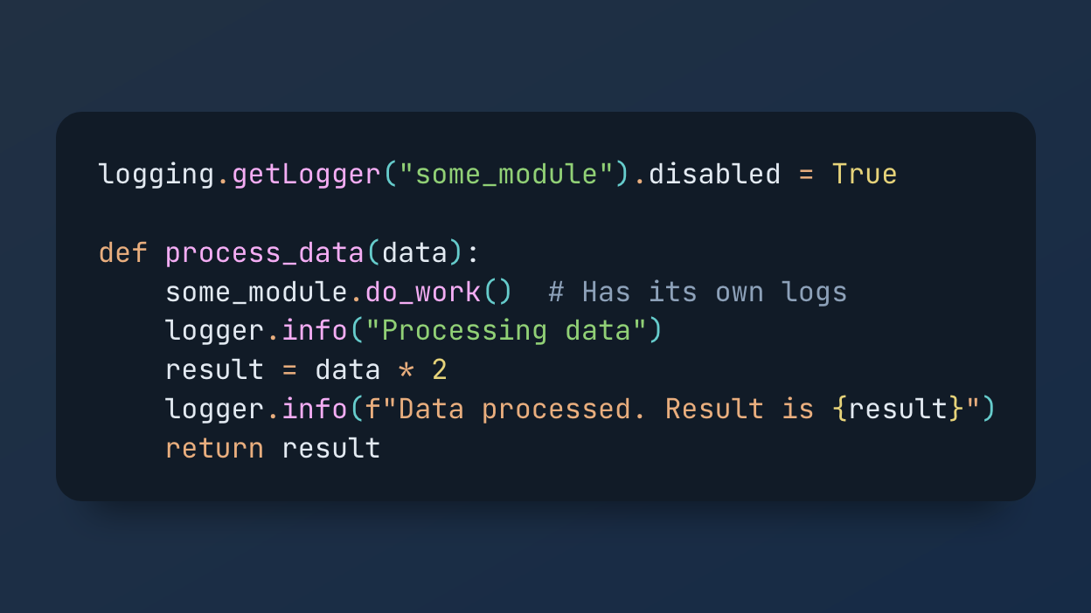
Managing logging in other modules
Let’s take a look
Example 6

Slide 11
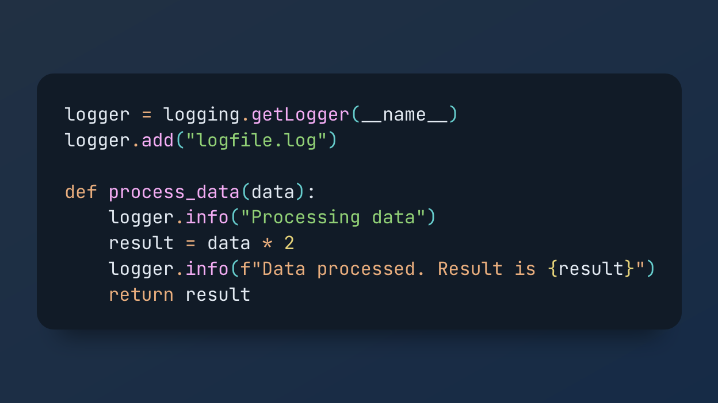
Logging to a file
Let’s take a look
Example 7

Slide 12
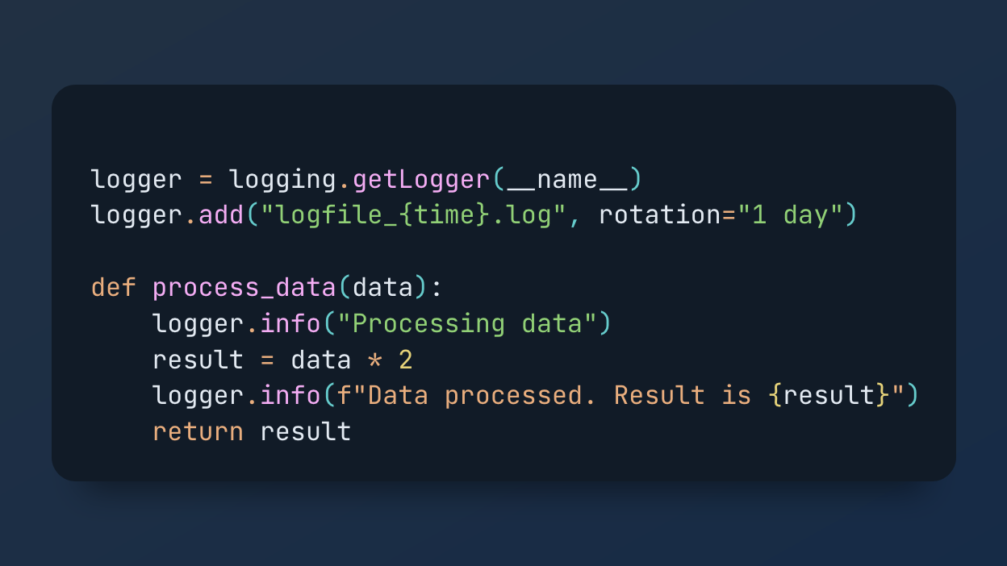
Files need rotation
Let’s take a look
Example 8

Slide 13

Your honour, objection!
Who rotates the log if the program stops?
How are we going to update rotation config?
What if logs occupy all space on the disk?

Slide 14
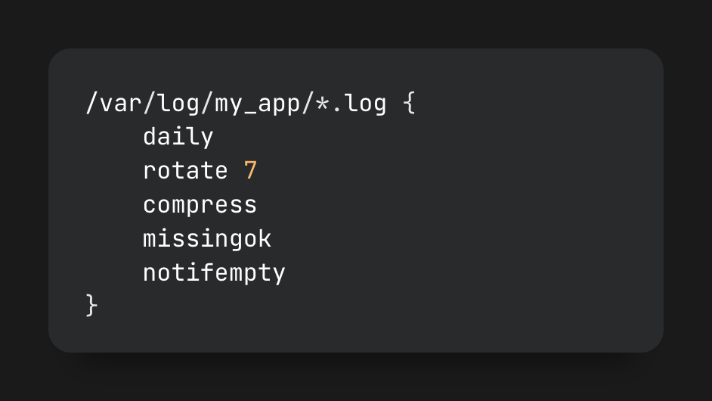
Files need rotation

Slide 15
Log search
Just grep it grep –i “192.168.2.3” my-logs.log
What if it’s archived? zcat my-logs.5.tar.gz | grep –i “192.168.2.3”
Grep with regex? Grep not through terminal? Aggregate? Regex?

Slide 16

Let’s add indexation Elastic / Splunk / Graylog / …

Slide 17
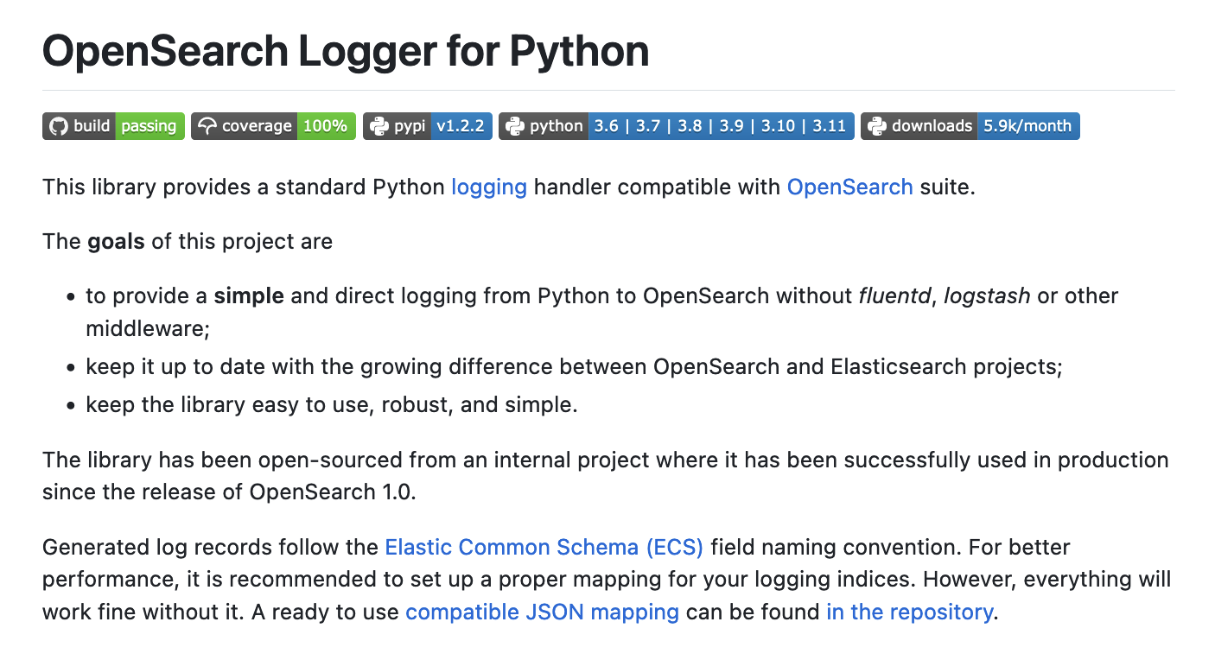

Slide 18
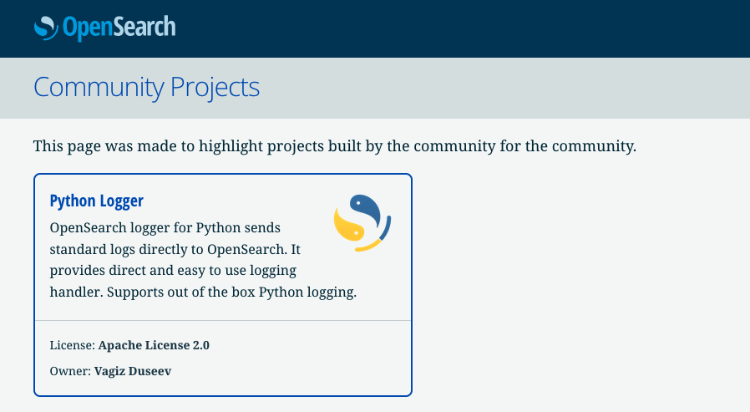

Slide 19
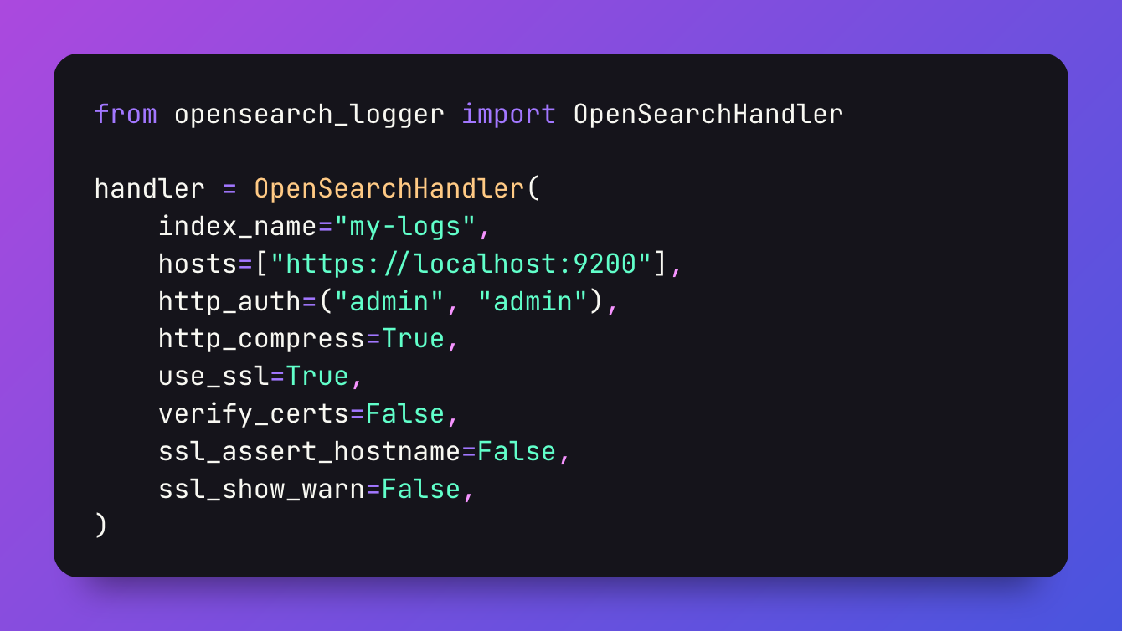
Configure handler
Example 9

Slide 20
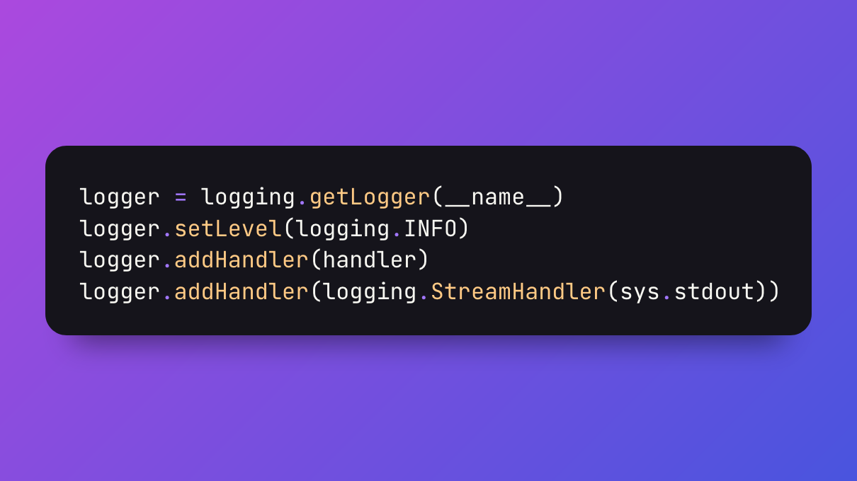
Still configuring handler …
Example 9

Slide 21
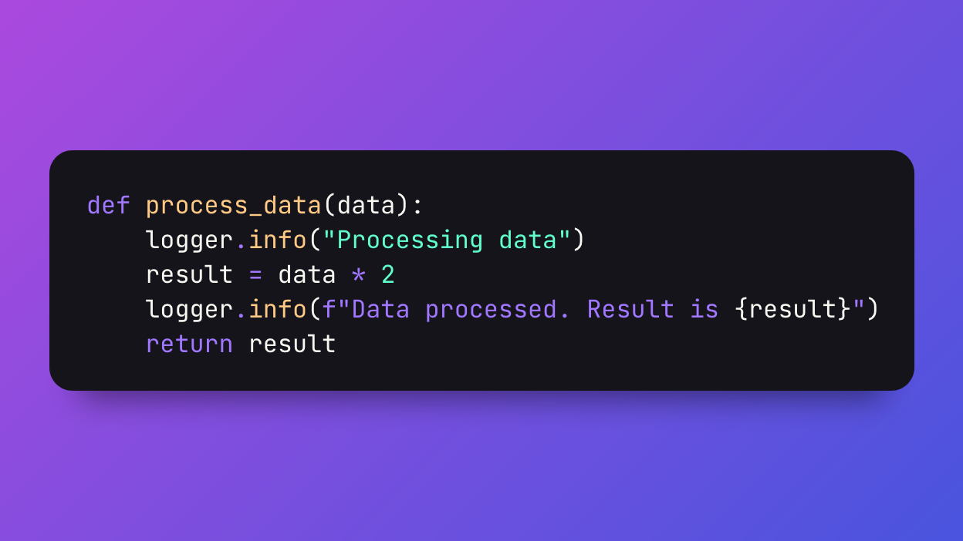
Same processing
Let’s take a look
Example 9

Slide 22
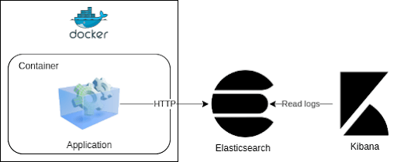

Slide 23
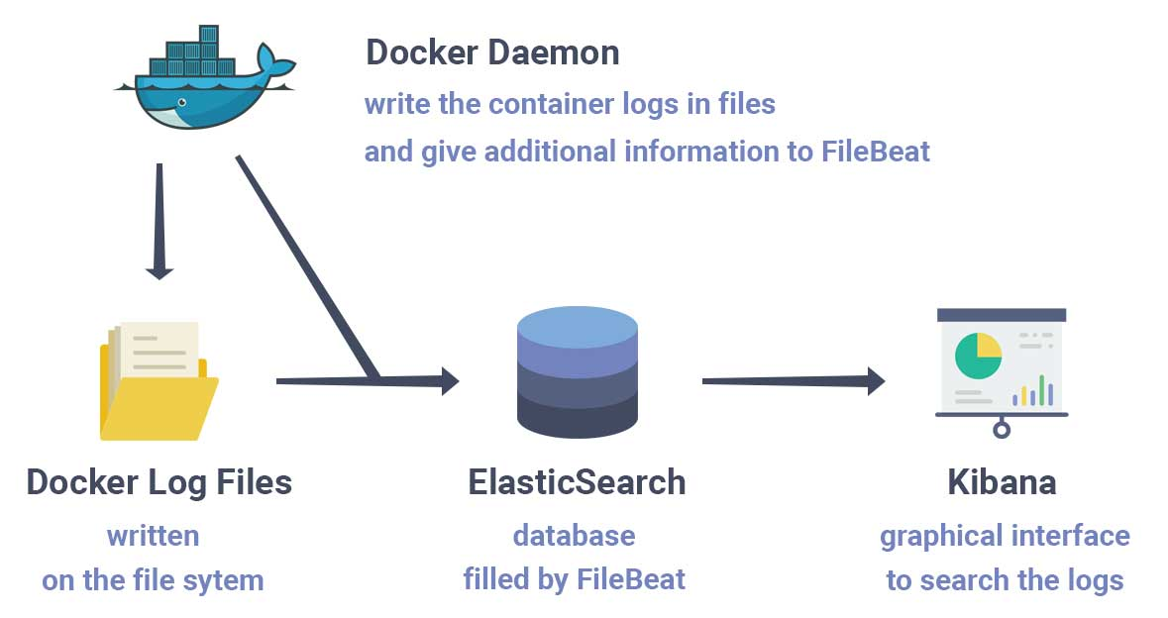

Slide 24
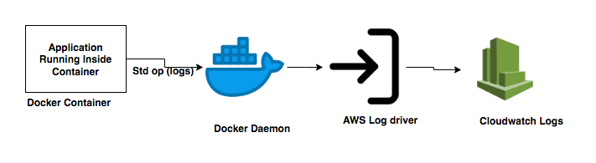

Slide 25
Big brain time
Logging config to control every aspect
Docker daemon drivers
FluentD for log collection
Let’s take a look

Slide 26


Slide 27
Perfect system
Open source
Stores logs, metrics, and traces
Tailored for
Lots of writes, small number of reads
On the flight analytics for alerting
Timeseries: all data has a timestamp
Horizontally scalable
Does not require running instances (except for alerting)
Does not require schema to be defined upfront
Agnostic to underlying storage

Slide 28



This concludes: Logging in Python
github.com/vduseev/python-logging
@vduseev
vagiz@duseev.com

